Slide 1
WEB PAGE DEVELOPMENT
MADE BY:
AMIT KUMAR TIWARI
SAJAL KIRTIMAN
SOUVIK PAL
SUBHAM GUPTA

Slide 2

GUIDED BY
MRS.
SHYAMA MANDAL

Slide 3

What does Web Development mean?
Web development refers to the tasks associated with developing websites for hosting via intranet or Internet. The Web development process includes Web design, Web content development, client-side/server-side scripting and network security configuration, among other tasks. Web development is also known as website development

Slide 4

Web Development
Web development is the coding or programming that enables website functionality, per the owner's requirements. It mainly deals with the non-design aspect of building websites, which includes coding and writing markup.

Slide 5
The Web development hierarchy is as follows:
Client-side coding
Server-side coding
Database technology
Web development ranges from creating plain text pages to complex Web-based applications, social network applications and electronic business applications.

Slide 6

WHAT WE HAVE DONE
WE HAVE MADE A PROJECT ON ON-LINE BOOK SHOPPING.
OUR WEBSITE SALES DIFFERENT CATEGORIES OF BOOK.

Slide 7
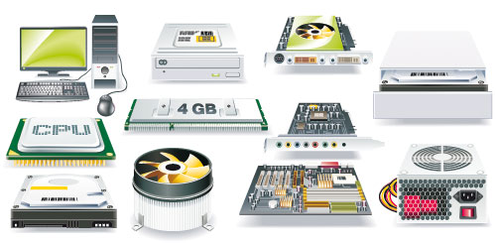
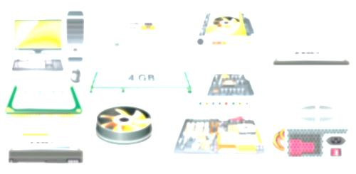
HARDWARE REQUIREMENTS
System: Pentium IV 2.4 GHz
Hard-disk: 40GB
RAM: 2GB
Monitor: 15 VGA color
Mouse: Optical
Keyboard: 110 keys enhanced

Slide 8
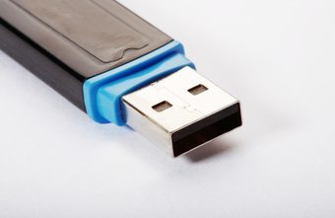
SOFTWARE REQUIREMENTS
In case of Server side:
Operating System: Windows 7, Linux
Software: Eclipse, Apache Tomcat, Mysql , JDBC
Platform: JAVA compatible
In case of Client Side:
Operating System: Windows, Linux
Web Browser: Mozilla Firefox, Google Chrome, Internet Explorer

Slide 9

WHY ONLINE BOOK SHOPPING
Online book shopping (sometimes known as e-tail from "electronic retail" or e-shopping) is a form of electronic commerce which allows consumers to directly buy goods or services from a seller over the Internet using a web browser.
It allows us to buy books suited to our interests and that too while relaxing at home at anytime of the day or night.
It offers books of huge variety of authors and titles, not only the popular ones but also the lesser known ones.

Slide 10

Benefits of online purchase of book
We can find books on any genre at an online bookstore, be it fantasy, science fiction, cookery books or novels. At a physical book store, finding an uncommon book may be difficult or ordering for a rare tome could take weeks for it to arrive, while the same book can easily be ordered online and delivered to your doorstep within a couple of days.

Slide 11
next benefit…….
The convenience of an online bookstore is a major consideration for especially those who living in areas where the access to a large bookstore is limited or is quite far away. One can easily order books from an online bookstore without the restrictions of specific store timings, long queues at the cash counter or the hassles of parking or traffic, and that too while sitting in the comfort of your home.
One of the most important advantages of an online bookstore is the cost. With the presence of several online bookstores on the web nowadays, as a prospective customer, you are able to compare prices of books and delivery charges online.

Slide 12
Feature supported by our project
Searching book seating at home
Ordering book
Cash on delivery

Slide 13

Let’s see the features of project

Slide 14

Scope of improvement
We are hope full to implement online mode of payment
We are trying implement dynamic searching
i.e event trigger on new character insertion

Slide 15
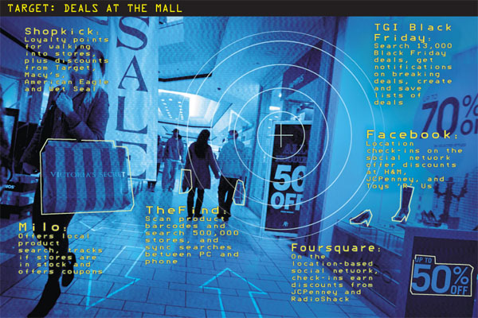
Future of online shopping in india
The e-commerce industry in India is still in its early stages of development. Online shopping in India is growing fast, aided by the fact that the number of Indians with access to fast broadband internet and smartphones is increasing by leaps and bounds every year. There’s been a massive increase in the use of the Internet and this is expected to continue over the next 4-5 years as well.

Slide 16
Continue….
Indeed, the online shopping industry in India is expected to clock a compounded annual growth rate of 35%. It is expected to cross the $100 billion mark by 2020, up from the $17 billion that it is worth today.

Slide 17
Continue..
This is great news because Internet in India has so far been a largely urban phenomenon. As more people in rural India take to the Internet, we expect online retailers in the country modify their business models slightly so as to make rural India a part of their growth strategy as well. There’s a lot of hidden potential here, which is waiting to be explored.

Slide 18
Last but not the least
We will try to make our web more safe and secure.
With growing demand we will try to meet the requirement.
We are trying to develop mobile app for the same.

Slide 19
Screenshots

Slide 20
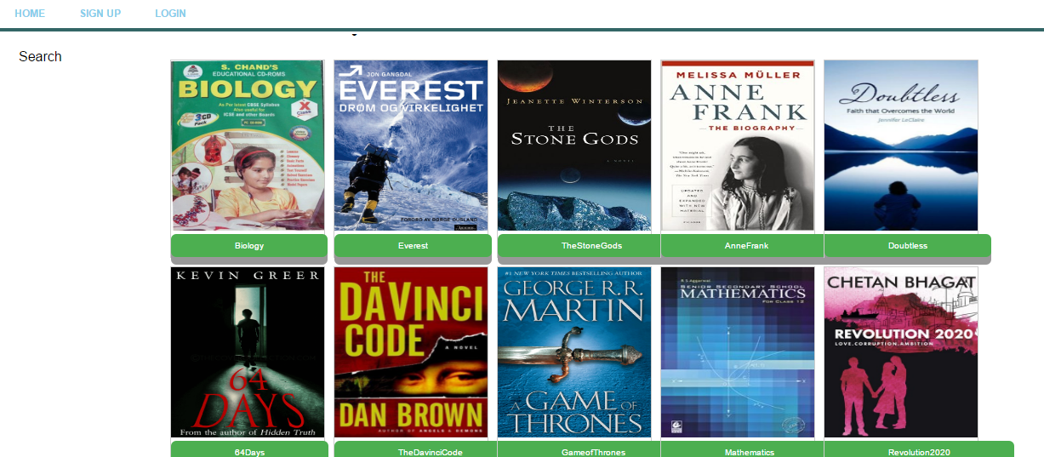

Slide 21
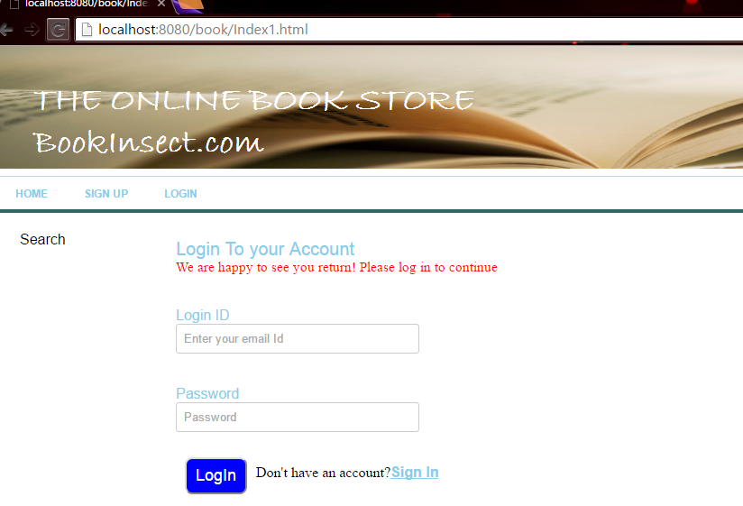

Slide 22
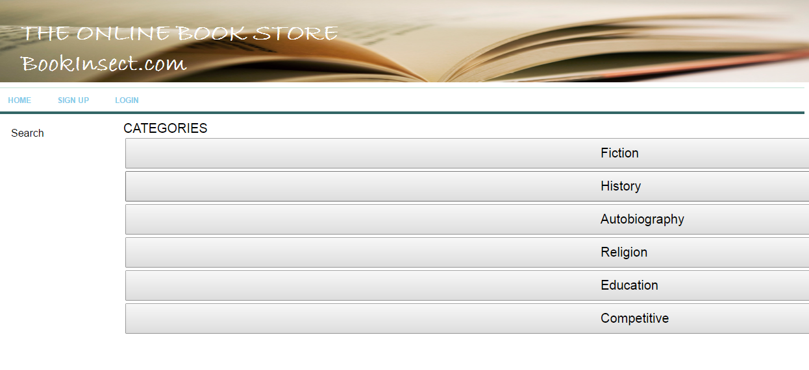

Slide 23
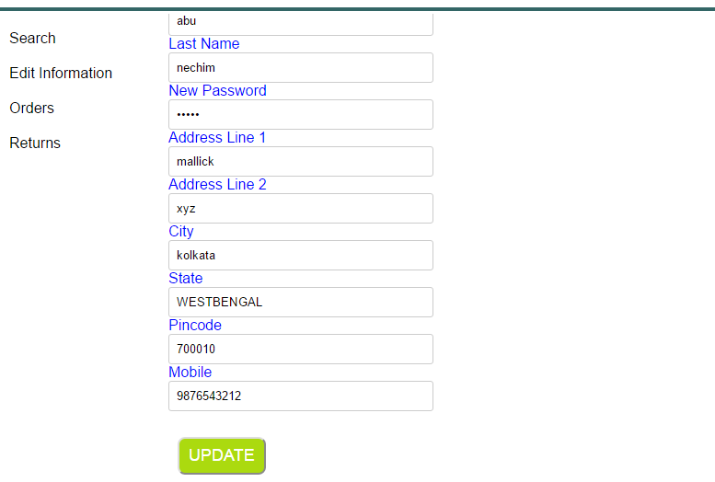

Slide 24
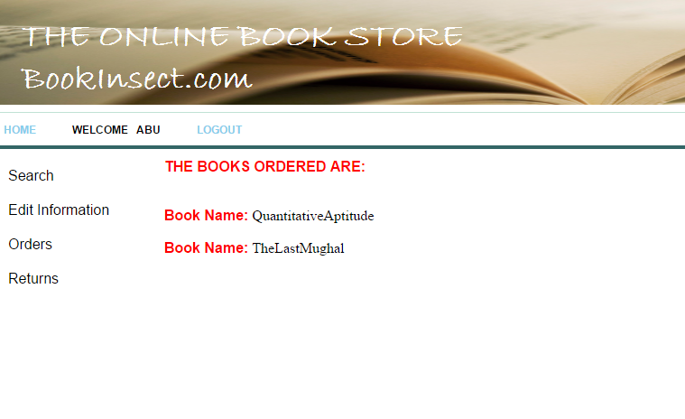

Slide 25
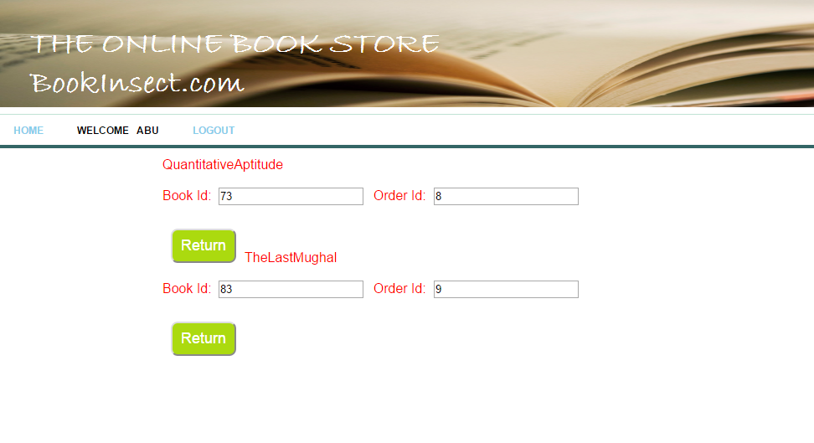

Slide 26
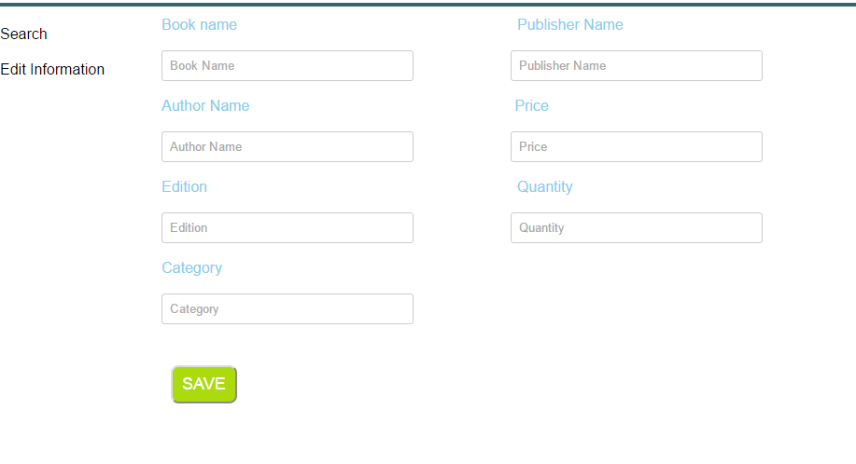

Slide 27
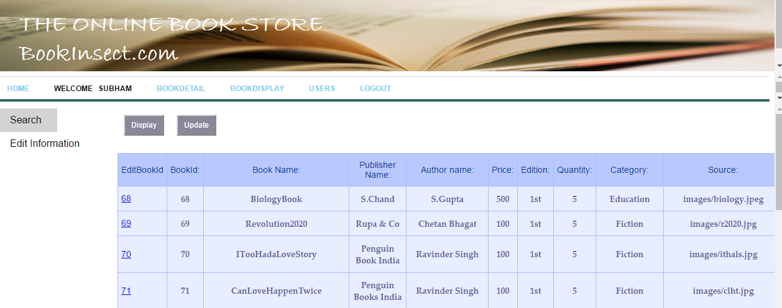

Slide 28

Any question

Slide 29


